Slide 1
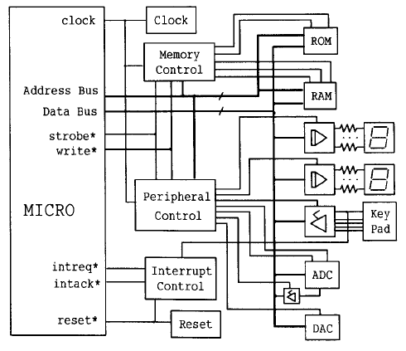
Peripheral and its characteristics

Slide 2


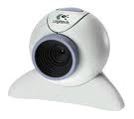


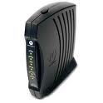



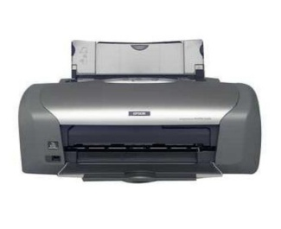

Introduction
R
A
M
Processor
Computer Systems
Internal (processor + memory (RAM) )
Peripheral (Disk, Display, Audio, Eth,..)

Slide 3
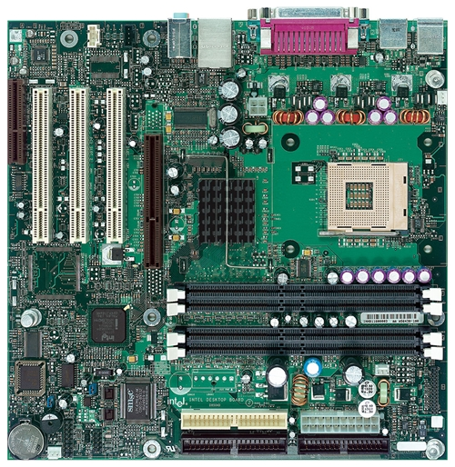
Intel D850MD Motherboard
mouse, keyboard, parallel, serial, and USB connectors
Video
Audio chip
PCI slots
memory controller hub
Pentium 4 socket
AGP slot
dynamic RAM
Firmware hub
I/O Controller
Speaker
Power connector
Battery
Diskette connector
IDE drive connectors

Slide 4
Exceptions
An exception is a transfer of control to the OS kernel in response to some event (i.e., change in processor state)
Kernel is the memory-resident part of the OS
Examples of events: Divide by 0, arithmetic overflow, page fault, I/O request completes, typing Ctrl-C
User code
Kernel code
Event
I_current
Exception
I_next
Exception processing
by exception handler
Return to I_current
Return to I_next
Abort

Slide 5
Control Flow
Processors do only one thing:
From startup to shutdown, a CPU simply reads and executes (interprets) a sequence of instructions, one at a time
This sequence is the CPU’s control flow (or flow of control)
Physical control flow
<startup>
inst₁
inst₂
inst₃
…
inst_{n}
<shutdown>
Time

Slide 6
Altering the Control Flow
Up to now: two mechanisms for changing control flow:
Jumps and branches
Call and return
React to changes in program state
Insufficient for a useful system: Difficult to react to changes in system state
Data arrives from a disk or a network adapter
Instruction divides by zero
User hits Ctrl-C at the keyboard
System timer expires
System needs mechanisms for “exceptional control flow”

Slide 7
Exceptional Control Flow
Exists at all levels of a computer system
Low level mechanisms
1. Exceptions
Change in control flow in response to a system event (i.e., change in system state)
Implemented using combination of hardware and OS software
Higher level mechanisms
2. Process context switch
Implemented by OS software and hardware timer
3. Signals
Implemented by OS software
4. Nonlocal jumps: setjmp() and longjmp()
Implemented by C runtime library

Slide 8
Exceptions
An exception is a transfer of control to the OS kernel in response to some event (i.e., change in processor state)
Kernel is the memory-resident part of the OS
Examples of events: Divide by 0, arithmetic overflow, page fault, I/O request completes, typing Ctrl-C
User code
Kernel code
Event
I_current
Exception
I_next
Exception processing
by exception handler
Return to I_current
Return to I_next
Abort

Slide 9
Exception Tables
Exception
numbers
Code for
exception handler 0
Each type of event has a unique exception number k
k = index into exception table (a.k.a. interrupt vector)
Handler k is called each time exception k occurs
Exception
Table
Code for
exception handler 1
0
1
Code for
exception handler 2
2
...
n-1
...
Code for
exception handler n-1

Slide 10
Taxonomy
ECF
Asynchronous
Synchronous
Interrupts
Traps
Faults
Aborts

Slide 11
Asynchronous Exceptions (Interrupts)
Caused by events external to the processor
Indicated by setting the processor’s interrupt pin
Handler returns to “next” instruction
Examples:
Timer interrupt
Every few ms, an external timer chip triggers an interrupt
Used by the kernel to take back control from user programs
I/O interrupt from external device
Hitting Ctrl-C at the keyboard
Arrival of a packet from a network
Arrival of data from a disk

Slide 12
Synchronous Exceptions
Caused by events that occur as a result of executing an instruction:
Traps
Intentional
Examples: system calls, breakpoint traps, special instructions
Returns control to “next” instruction
Faults
Unintentional but possibly recoverable
Examples: page faults (recoverable), protection faults (unrecoverable), floating point exceptions
Either re-executes faulting (“current”) instruction or aborts
Aborts
Unintentional and unrecoverable
Examples: illegal instruction, parity error, machine check
Aborts current program

Slide 13
System Calls
Each x86 system call has a unique ID number
Examples:
Number | Name | Description
0 | read | Read file
1 | write | Write file
2 | open | Open file
3 | close | Close file
4 | stat | Get info about file
57 | fork | Create process
59 | execve | Execute a program
60 | _exit | Terminate process
62 | kill | Send signal to process

Slide 14
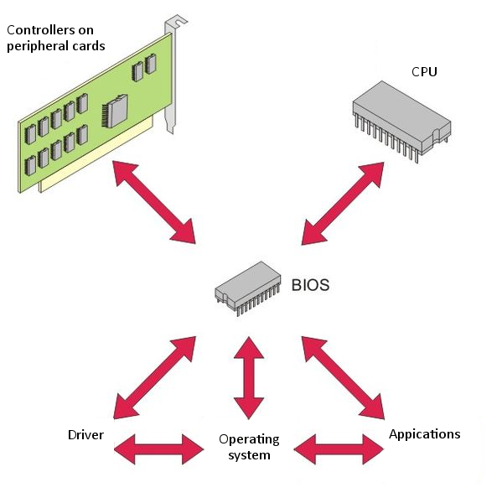

Slide 15
Outline
Introduction to peripheral
Type of peripheral (I/O)
Characteristics of peripheral (I/O)
Method of getting/sending data from/to I/O
Programmable Peripheral Interface
Peripheral controller (8255A)

Slide 16
Hierarchy of I/O Control Devices
2 Port (A,B),
No Bidirectional
HS mode (C)
4 mode timer
8155
I/O + Timer
8253/54
Timer
8255
I/O
2 Port (A,B)
A is Bidirectional
HS mode (C)
Extra controls
6 mode timer
8259
Interrupt controller
8237
DMA controller
8251
Serial I/O USART controller

Slide 17
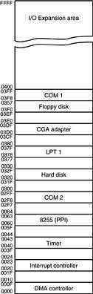
I/O map of a personal computer illustrating many of the fixed I/O areas.
Personal Computer I/O Map
the PC uses part of I/O map for dedicated functions, as shown here
I/O space between ports 0000H and 03FFH is normally reserved for the system and ISA bus
ports at 0400H–FFFFH are generally available for user applications, main-board functions, and the PCI bus
80287 coprocessor uses 00F8H–00FFH, so Intel reserves I/O ports 00F0H–00FFH

Slide 18
Outside MPU
RAM Memory is integral part of MP System
MPU fetch instruction from RAM
MPU RD and WR data to RAM (same speed as MPU)
How Ram is interfaced
8085
MPU
A₁₅
Address Bus (16bit)
A₀
Memory
I/P
O/P
_{D7}
Data Bus (8bit)
_{D0}
Control Bus (8bit)

Slide 19
Primary function of MPU
Read Instruction from memory
Execute instruction
Read/Write data to memory
Some time send result to output device
LEDs, Monitor, Printer
Interfacing a peripheral
Why: To enable MPU to communicate with I/O
Designing logic circuit H/W for a I/O
Writing instruction (S/W)

Slide 20
Type of I/O
Peripheral I/O
IN port (Instruction), OUT port (instruction)
Identified with 8 bit address (Immediate)
Example: IN 01H ; Receive data from port 1
Memory mapped I/O
A peripheral is connected as if it were a memory location
Identified with 16 bit address
Data transfer by : LDA, STA, MOV M R, MOV R M

Slide 21
Mode of Data transfer
Parallel
Entire 8bit or 16 bit transfer at one time
In 8085 entire 8 bit transferred simultaneous using 8 data lines
Seven Segment LEDs, Data converter (ASCIItoHEX), Memory
Serial
Data transferred one bit at a time
Parallel to serial conversion (parallel 8 bit to stream of serial 8 bit)
Serial to Parallel conversion
Modem, USB, SATA, and (sometimes monitor/printer)
UART: Universal Asynchronous Receiver & Transmitter

Slide 22
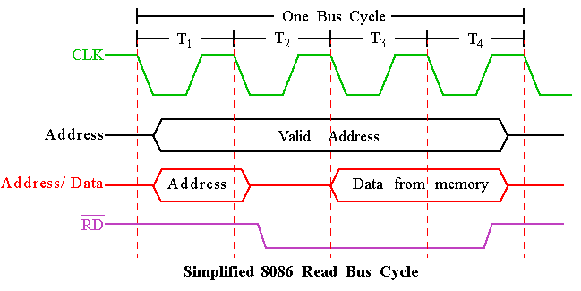
Timing Diagram : Read Cycle

Slide 23
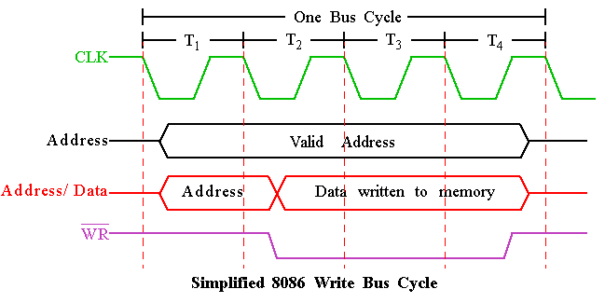
Timing Diagram : Write Cycle

Slide 24
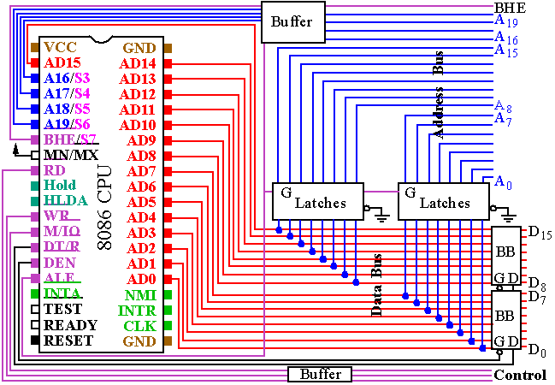
BUS Buffering and Latching

Slide 25
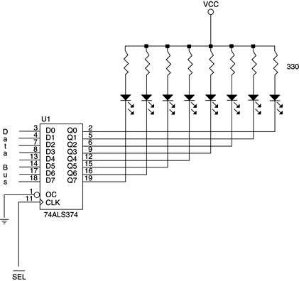
The basic output interface connected to a set of LED displays.

Slide 26
Stepper motor interface Diagram
26

Slide 27
8255 PPI Programmable Peripheral Interface

Slide 28
Outline
8255 PPI
8255 PPI Pin Configuration
8255 operating modes
16-bit data bus to 8-bit peripherals
MODE 0 Application (Keyboard)
MODE 1 Application (Printer)
MODE 2 Application (Printer)

Slide 29
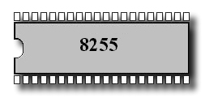
The 8255A is a programmable peripheral interface (PPI) device designed for use in Intel microcomputer systems. Its function is that of a general purposes I/O component to Interface peripheral equipment to the microcomputer system bush. The functional configuration of the 8255A is programmed by the systems software.

Slide 30
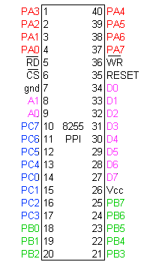
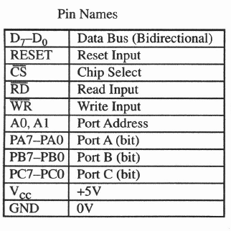
Pin Configuration

Slide 31
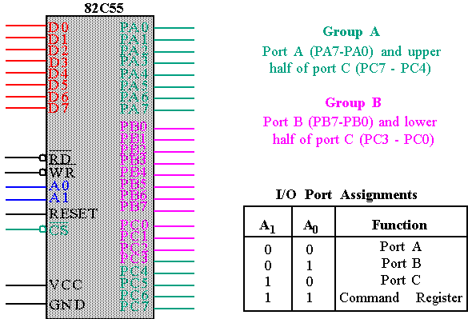
82C55 : Pin Layout

Slide 32
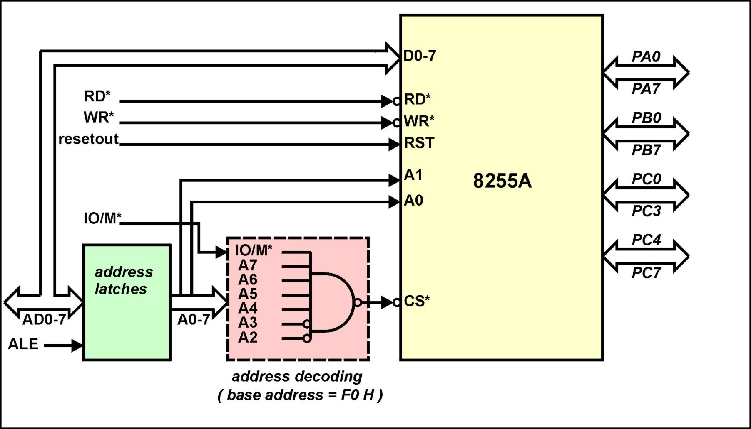
8255A - 8085A Interface

Slide 33
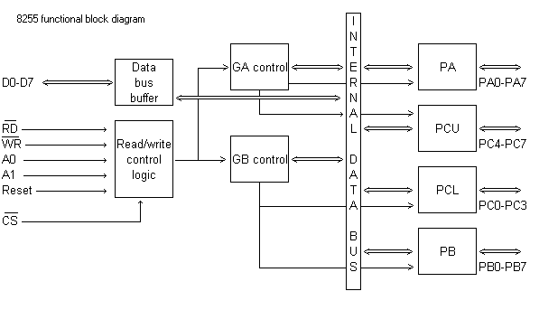
8255 A Block Diagram Showing Data Bus Buffer and Read/Write Control Logic Functions

Slide 34
Pin Configuration
(CS)Chip Select. A “low’ on this input pin enables the communication between the 8255A, and the CPU.
(RD) Read. A “low” on this Input pin enables the 8255A to send the data or status information to the CPU on the data bus. In essence, it allows the CPU to “read from the 8255A.
(WR) Write. A. “ low” on the input pin enables the CPU to write data or control words into the 8255A.
(A0 and A1)
Port Select 0 and Port Select 1. The Input signals, in conjunction with the RD and WR Inputs, controls the selection of one of the three ports or the control word registers. They are normally connected to the least significant bits of the address bus (A0 and A1).

Slide 35
Interface Registers
A1 A0 RD WR CS Input Operation (Read)
0 0 0 1 0 Port A - Data Bus
0 1 0 1 0 Port B - Data Bus
1 0 0 1 0 Port C - Data Bus
1 1 0 1 0 Control Word - Data Bus
Output Operation (Write)
0 0 1 0 0 Data Bus - Port A
0 1 1 0 0 Data Bus - Port B
1 0 1 0 0 Data Bus - Port C
1 1 1 0 0 Data Bus - Control

Slide 36
Ports A, B and C
Ports A, B, and C
The 8255A contains three 8-bit ports (A , B, and C). All can be configured in a wide variety of functional characteristics by the system software but each has its own special features or personally to further enhance the power and flexibility of the 8255A.
Port A. One 8 bit data output latch/buffer and one 8-bit data input latch.
Port B. One 8-bit data output latch/buffer and one 8-bit data input buffer.
Port C. One 8-bit data output latch/buffer and one 8-bit data input buffer (no latch for input). This port can be divided into two 4-bit ports under the mode control. Each 4-bit port contains a 4-bit latch and it can be used for the controls signal outputs and status signal inputs in conjunction with ports A and B.

Slide 37
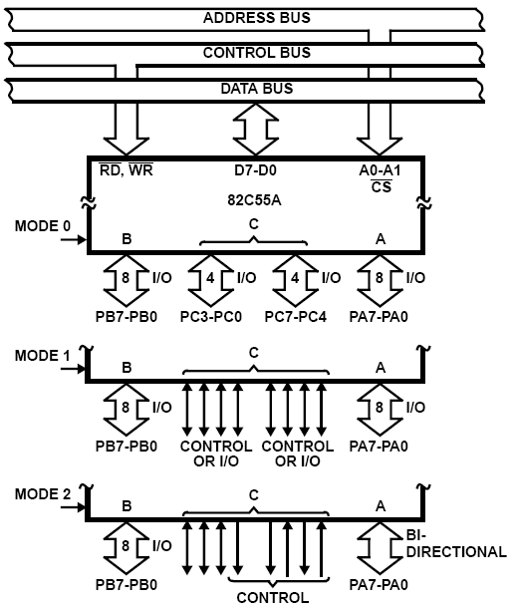
8255A OPERATIONAL DESCRIPTION
Mode Selection
There are three basic modes of operation that can be selected by the systems software:
Mode O – Basic Input/Output
Mode 1 – Strobed Input/Output
Mode 2 – Bi-Directional Bus

Slide 38
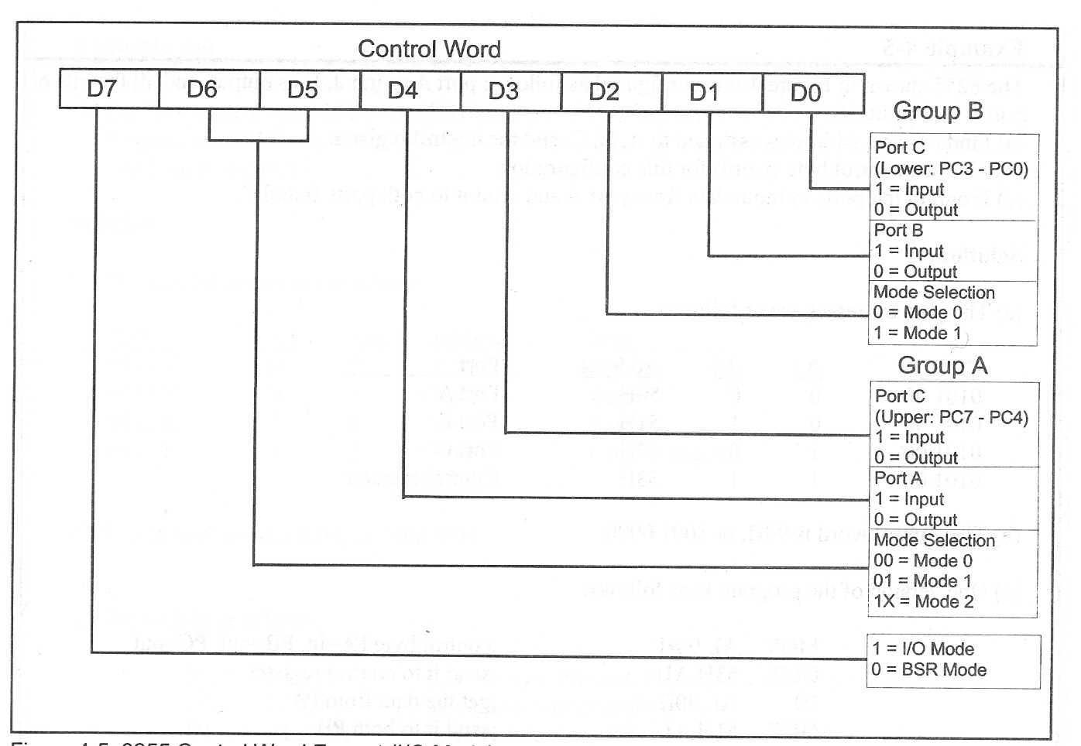
8255 Control Word Mode Definition Format

Slide 39
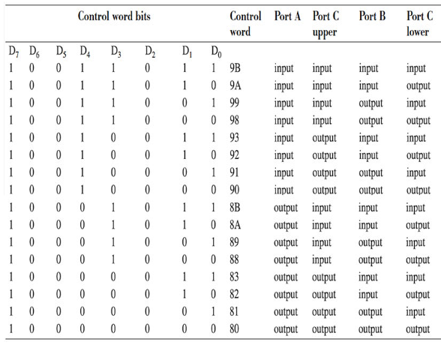
8255 Control Word

Slide 40
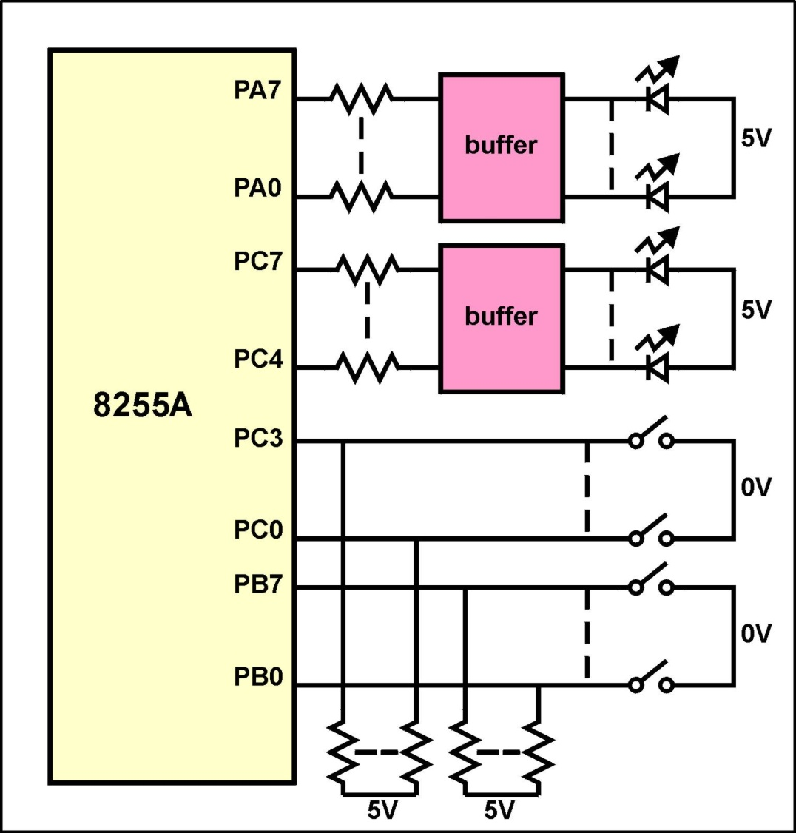
Example of 8255A Operating in Mode 0
Write a program that reads the state of the 12 switches and displays the switch state on the 12 LEDs

Slide 41
Example of 8255A Operating in Mode 0
The assembly language program is : MVI A, 83 H ;A= out B= in C(lo)= in C(hi)= out OUT F3 H ; write the control word IN F1 H ; read switches on port B OUT F0 H ; display on port A IN F2 H ; read switches on port C (lo) ANI 0F H ; mask top 4-bits - not switch data RLC RLC RLC RLC ; move bottom 4-bits of A to top OUT F2 H ; output reg A to port C

Slide 42
Intel 8255 PPI
Chip Select Circuit
A7
M/IO*
A7=0, A6=1, A5=1, A4=1, A3=1, A2=1, & M/IO*= 0

Slide 43
8255 –port address
When CS (Chip select) is 0, 8255 is selected for communication by the processor. The chip select circuit connected to the CS pin assigns addresses to the ports of 8255. For the chip select circuit shown, the chip is selected when A7=0, A6=1, A5=1, A4=1, A3=1, A2=1, & M/IO*= 0 Port A, Port B, Port C and Control port will have the addresses as 7Ch, 7Dh, 7Eh, and 7Fh respectively.

Slide 44
Ex. :Circuit Diagram
D0-D7
8255
PPI
CS
RD#
WR#
A1
A0
D0-D7
A3
A4
A5
A0
A1
0
1
2
3
4
5
6
7
From CPU
A2
‘138
M/IO#
A0
E1
E2
A7
A6
E3
IORDC#
IOWRC#
A2
A1

Slide 45
Use only even addresses
Example: We want to use a 8255 PPI with the starting I/O address of F8h. Use even adresses only.
A7 A6 A5 A4 A3 A2 A1 A0
f8h 1 1 1 1 1 0 0 0 B : Port A
fah 1 1 1 1 1 0 1 0 B : Port B
fch 1 1 1 1 1 1 0 0 B : Port C
feh 1 1 1 1 1 1 1 0 B : Control Reg.
Register Select

Slide 46
Access to Interface Registers
Port B and C are programmed as Mode 0 input port.
Port A is programmed as Mode 0 simple latched output port.
Write a code to implement the operation
PortA=PortB-PortC
mov AL,8Bh ;control word
out FEh,AL ;written to control reg.
in AL,FCh ;Read Port C
mov BL,AL ;
in AL,FAh ;Read Port B
sub AL,BL ;PortB-PortC
out F8h,AL ;write PortA

Slide 47
Solution 2: Use only odd addresses
Example: We want to use a 8255 PPI with the starting I/O address of F9h. Use odd adresses only.
A7 A6 A5 A4 A3 A2 A1 A0
f9h 1 1 1 1 1 0 0 1 B : Port A
fbh 1 1 1 1 1 0 1 1 B : Port B
fdh 1 1 1 1 1 1 0 1 B : Port C
ffh 1 1 1 1 1 1 1 1 B : Control Reg.
Register Select

Slide 48
Circuit Diagram
D0-D7
8255
PPI
CS
RD#
WR#
A1
A0
D8-D15
A3
A4
A5
A0
A1
0
1
2
3
4
5
6
7
From CPU
A2
‘138
M/IO#
E1
A0
E2
A7
A6
E3
IORDC#
IOWRC#
A2
A1

Slide 49
Solution 3: Use consecutive even and odd address
Example: We want to use a 8255 PPI with the starting I/O address of C0h. Use even and odd adresses.
A7 A6 A5 A4 A3 A2 A1 A0
C0h 1 1 0 0 0 0 0 0 B : Port A
C1h 1 1 0 0 0 0 0 1 B : Port B
C2h 1 1 0 0 0 0 1 0 B : Port C
C3h 1 1 0 0 0 0 1 1 B : Control Reg.
Register Select

Slide 50
8255 MD Control word Contd.
Ex. 1: Configure Port A as i/p in Mode 0, Port B as o/p in mode 0, Port C (Lower) as o/p and Port C (Upper) as i/p ports.
Required MD control word:
 |  | 1 | 0 | 0 | 1 | 1 | 0 | 0 | 0 | = |  | 98H
MD control |  |  |  |  |  |  |  |  | PC Lower as o/p
 | PA in Mode 0 |  |  |  |  |  |  | PB as o/p Reqd. instrns.
 |  | PA as i/p |  |  |  |  | PB in Mode 0 |  |  |  | MOV AL, 98H
 |  |  |  |  |  | PC Upper as i/p |  |  |  |  | OUT 7FH, AL

Slide 51
8255 MD Control word Contd.
Ex. 2: Configure Port A as i/p in Mode 1, Port B as o/p in mode 1, Port C7-8 as i/p ports. (PC5-0 are handshake lines, some i/p lines and others o/p. So they are shown as X)
Required MD control word:
 |  | 1 | 0 |  | 1 | 1 | 1 | 1 | 0 | X | = |  | BCH or BDH
MD control |  |  |  |  |  |  |  |  |  | PC3-0 as don’t care
 | PA in Mode 1 |  |  |  |  |  |  |  | PB as o/p Reqd. Instrns.
 |  | PA as i/p |  |  |  |  |  | PB in Mode 1 |  |  |  | MOV AL,BCH
 |  |  |  |  |  | PC Upper(C7-8) as i/p |  |  |  |  |  | OUT 7FH, AL

Slide 52
Example - Port addresses

Slide 53
Solution

Slide 54
Example – Programming 8255

Slide 55
Solution

Slide 56
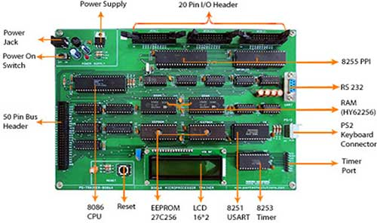

Slide 57
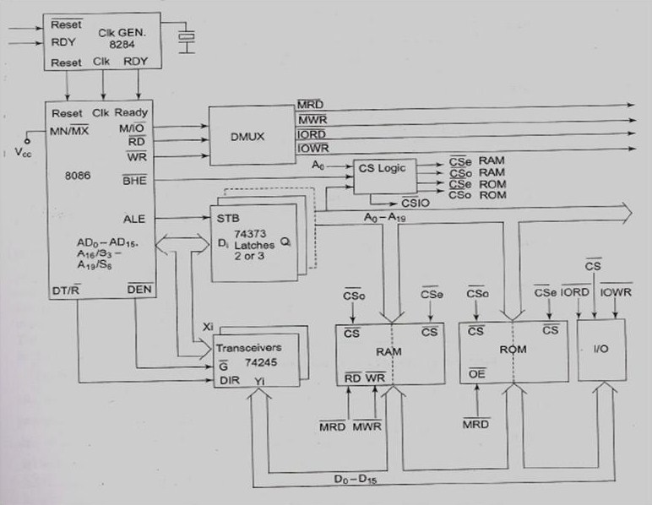

Slide 58
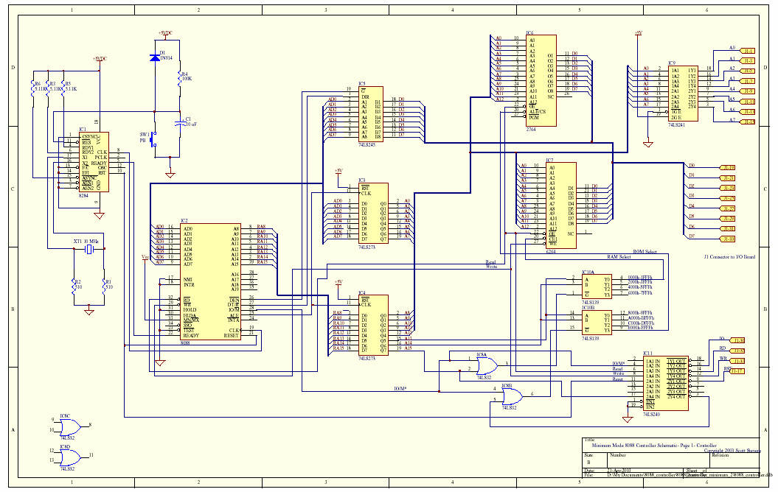

Slide 59
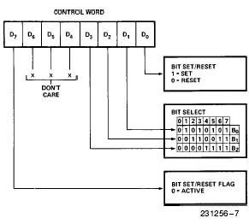
Bit Set Reset (BSR) mode

Slide 60
Example for BSR
Program 8255 for the following
A) set PC2 to high
B) Use PC6 to generate a square wave of 66% duty cycle
Solution
A)
MOV AL, 00000101B OUT 92H,AL
B)
AGAIN MOV AL, 0xxx1101 OUT 92H, AL CALL Delay CALL Delay MOV AL, 0xxx1100 OUT 92H, AL CALL Delay JMP AGAIN

Slide 61
Mode 0: Example
This functional configuration provides simple input and output operations for each of the three ports. No ``handshaking'‘ is required, data is simply written to or read from a specified port.
Mode 0 Basic Functional Definitions:
Two 8-bit ports and two 4-bit ports.
Any port can be input or output.
Outputs are latched.
Inputs are not latched.
16 different Input/Output configurations are possible
in this Mode.

Slide 62
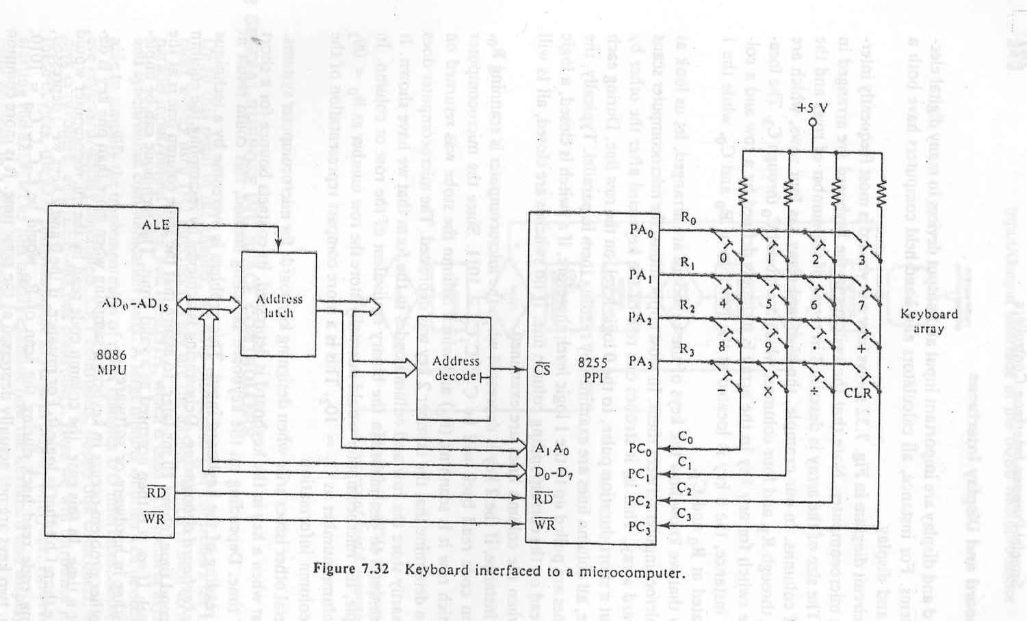
MODE 0 Application (Keyboard Interface)

Slide 63
MODE 0 Application (Keyboard Interface)
The switches in the keyboard are arranged in an array. The size of the array is described in terms of the number of rows and the number of the columns.
In our example, the keyboard array has four rows, which are labeled R₀ through R₃, and four columns, which are labeled C₀ through C₃. The location of the switch for any key in the array is uniquely defined by a row and a column.
For instance, the 0 key is located at the junction of R₀ and C₀, while the 1 key is located at R₀ and C₁.
In most applications, the microcomputer scans the keyboard array. That is, it strobes one row of the keyboard after the other by sending out a short-duration pulse, to the 0 logic level, on the row line. During each row strobe, all column lines are examined by reading them in parallel.
Typically, the column lines are pulled up to the 1 logic level; therefore, if a switch is closed, a logic 0 will be read on the corresponding column line. If no switches are closed, all 1s will be read when the lines are examined.

Slide 64
MODE 0 Application (Keyboard Interface)
The starting address for this I/O interface is 10H and consecutive even addresses are used.
10h: 0 0 0 1 0 0 0 0B -Port A (Output port)
12h: 0 0 0 1 0 0 1 0B -Port B (Unused output port)
14h: 0 0 0 1 0 1 0 0B -Port C (lower and higher input)
16h: 0 0 0 1 0 1 1 0B -Control Reg.
PORTA EQU 10h
PORTB EQU 12h
PORTA EQU 14h
CREG EQU 16h
CWD EQU 10001001b
MOV AL, CWD
OUT CREG,AL

Slide 65
MODE 0 Application (Keyboard Interface)
.
.
SCAN: MOV BL,FEH ; send a short-duration pulse, to the 0 logic level,
SCAN1: MOV AL,BL ; on the row line0.
OUT PORTA,AL
IN AL,PORTC ;Read PortC
XOR AL,FFH ;Complement AL
AND AL,0FH ;Mask unused nibble
CMP AL,0
JNE KEY ;if a key pressed go to KEY
ROL BL,1 ; if no key pressed, shift the ruration pulse to next row
CMP BL,FEH
JNE SCAN1
JMP SCAN
.
.
KEY: .
.

Slide 66
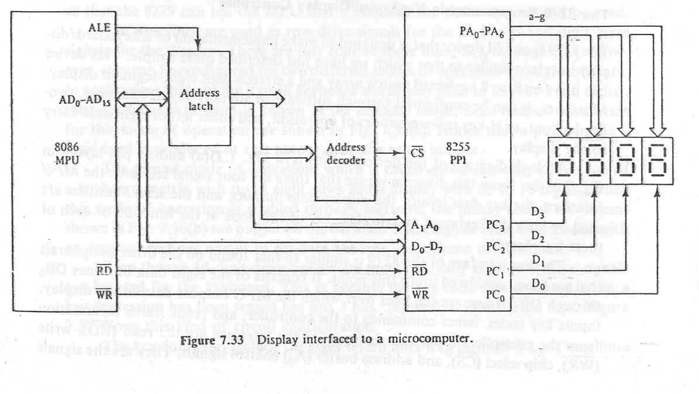
Mode 0 Application: Display Interface

Slide 67
MODE 1 (Strobed Input/Output).
This functional configuration provides a means for transferring I/O data to or from a specified port in conjunction with strobes or ``handshaking'' signals. In mode 1, Port A and Port B use the lines on Port C to generate or accept these ``handshaking'' signals.
Mode 1 Basic functional Definitions:
Two Groups (Group A and Group B).
Each group contains one 8-bit data port and one 4-bit control/data port.
The 8-bit data port can be either input or output
Both inputs and outputs are latched.
The 4-bit port is used for control and status of the 8-bit data port.

Slide 68
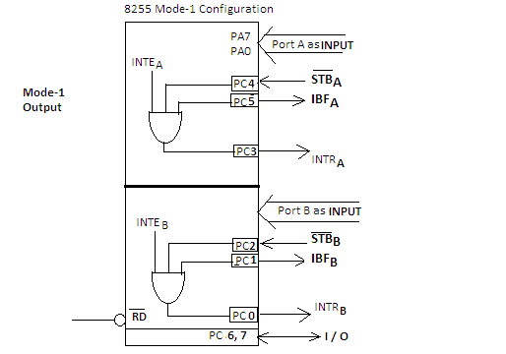
MODE 1 Input Operation
STB: This is an active low input to 8255A from the device to indicate that the device has transmitted a byte of data. 8255A in response generates an IBF and INTRA. IBF: In response to STB, 8255A generates and transmits an active high signal ‘IBF’ as an acknowledgement for receipt of data. This is reset (‘0’) after the MPU reads the data. INTE: 8255 has two internal flip-flops INTEA and INTEB. These are used to enable or disable the generation of INTR signal. These two FF are set/reset using the BSR mode. INTEA is enabled or disabled through PC4 and INTEB through PC2 INTR: For an interrupt driven I/O, an active high INTR signal is generated by 8255A that may be used to interrupt the MPU. As seen from figure, three signals STB’, IBF and INTE all at logic ‘1’ are input to an AND gate INTR is dropped when the data is read by the MPU at the falling edge of RD’ signal
Notes:
Status word is read from port c
Intea and inteb are written using PC6 and PC2

Slide 69
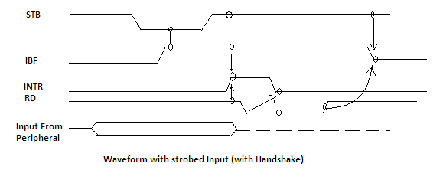
MODE 1 Timing (Input)
When a device is ready to send data using 8255 in mode-1 it sends the data on either port A or port B, the device also sends STB' signal to the 8255A to indicate that it has sent the data.
8255A sends an IBFA or IBFB signal depending on the port used for data transmission as an acknowledgement.
If the INTEA of INTEB flip-flop is set the 8255A generates an INTR signal which may be used to interrupt the MPU in interrupt driven I/O operation.
In status check I/O MPU continuously checks IBFA and/or IBFB for it to become high. When it finds IBF(A or B) high, MPU reads the data from PA or PB and resets the IBF(A or B). If mechanism of IO is interrupt based, in that case when the MPU is interrupted it reads the data from the port and disables the interrupt.

Slide 70
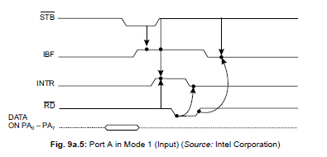
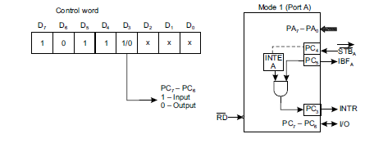
MODE 1 Timing (Input)

Slide 71
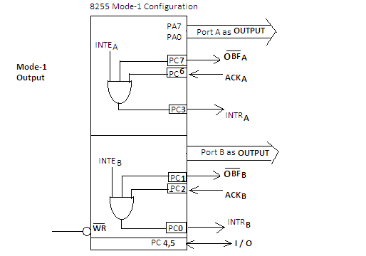
MODE 1 output Operation
INTE A :Controlled by bit set/reset of PC6.
INTE B: Controlled by bit set/reset of PC2.
Notes:
Status word is read from port c
Intea and inteb are written using PC6 and PC2

Slide 72
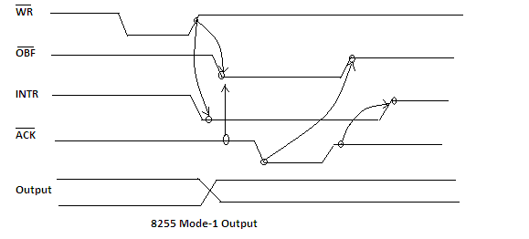
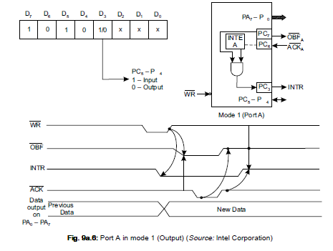
MODE 1 Timing (output)
During a write operation, the byte transmitted by the MPU, get stored in the output latch of port A or Port B. As the byte is written into the output latch of a port, the signal OBF' goes low to indicate that the output latch is full. The status of the oBF i.e. low or high indicate to the peripheral that it can read the data available in latch.
Now the MPU can transmit using either the status check I/O or Interrupt driven I/O.
If transmitting using the status check, OBF' is input to device, a low on OBF' indicate to the device that there is data byte in output buffer for the device. As the device get the data from the latch, it acknowledges it by sending a low ACK and then making it high and the OBF' becomes high after data read by peripheral device. The MPU can now transmit new data byte.
if transmitting using interrupt I/O when there is no data in output latch, then (OBF', ACK, INTE) are all high resulting in generation of INTR for the MPU for transmitting new data byte.

Slide 73
MODE 1 Timing (output)

Slide 74
Sample mode 1

Slide 75
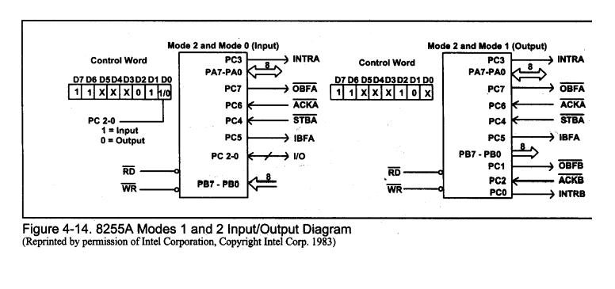
MODE 2 Operation

Slide 76
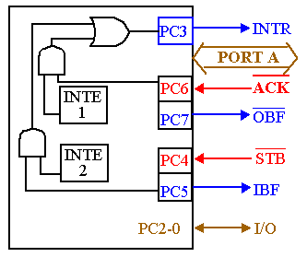
82C55: Mode 2 Bi-directional Operation
Timing diagram is a combination of the Mode 1 Strobed Input and Mode 1 Strobed Output Timing diagrams.

Slide 77
Summary of Port Connection for 8255

